Slide 1



An AI-Powered Flashcard Learning System Using SM-2 Spaced Repetition for Enhanced Student Memory Retention
PANIMALAR ENGINEERING COLLEGE
AN AUTONOMOUS INSTITUTION
AFFILIATED TO ANNA UNIVERSITY,CHENNAI
(JAISAKTHI EDUCATIONAL TRUST
Team Members: Vignesh S(211423104733), Vignesh D(211423104731)
Guide Name : Dr.Subedha V
Co-ordinators : Dr.Subedha V, Mrs. Sharmila
Batch Number : F22
SDG Goal : SDG 4-Quality Education

Slide 2
Base Paper Details
Title : Unveiling the Art of Effective Learning through Spaced Repetition and Evidence-Based Techniques
Authors : Kshitij Narkhede
Journal/Conference : 2024 IEEE International Conference
Year : 2024
Publisher : IEEE

Slide 3
Agenda
Introduction
Objectives
Literature Survey
Problem Statement
System Architecture
Use Case Diagram
Module Description
Algorithm /Methodology
Testing & Validation
Performance Analysis
Screenshots
Conclusion
Future Work
References

Slide 4
Introduction
In today’s fast-paced digital learning environment, students face challenges in retaining studied information.
Traditional revision methods lack structure and personalization, leading to poor long-term memory.
Spaced repetition is a scientifically proven technique that enhances learning and recall efficiency.
The SM-2 algorithm, originally used in Anki, automates review scheduling based on learner performance.
Artificial Intelligence (AI) enables automated flashcard generation from study materials.
The proposed system integrates AI with SM-2 to create an adaptive, intelligent, and user-friendly flashcard application.
The platform allows users to create, review, and track learning progress efficiently — even in offline mode.
This innovation aims to make digital learning more engaging, efficient, and accessible for all learners.

Slide 5
Objectives
Develop a flashcard learning app using the SM-2 spaced repetition algorithm.
Provide both manual and AI-assisted flashcard creation.
Enable subject-wise categorization for organized study.
Ensure offline accessibility and user-friendly interface.
Significance
Improves memory retention with scientifically proven spaced repetition.
Saves time through AI-powered flashcard generation.
Supports structured learning across multiple subjects.
Bridges digital education gaps, aligning with SDG 4 – Quality Education.

Slide 6
Literature Survey
Paper Title | Authors | Advantage | Disadvantage
Spaced Repetition Systems for Efficient Learning | K. Smith, J. Brown | Proves spaced repetition increases retention; validated in multiple student groups | Mostly focused on online tools like Anki; lacks offline solutions
Effectiveness of SM-2 Algorithm in Student Learning | M. Patel, R. Verma | Shows SM-2 is simple, reliable for memory scheduling | Limited experiments; not customized for non-technical learners
Adaptive Learning with Flashcards | S. Gupta, A. Roy | Personalized flashcards improve exam scores | Requires cloud-based infrastructure
Active Recall-Based Learning Systems | L. Johnson, P. White | Demonstrates active recall is better than passive rereading | Does not provide tracking or analytics
AI-Powered Flashcard Generation Using GPT | C. Lee, T. Nguyen | Proves GPT can create meaningful flashcards from raw text | Needs internet access and high compute resources

Slide 7
Paper Title | Authors | Advantage | Disadvantage
Offline Learning Tools for Rural Education | H. Kumar, D. Singh | Highlights need for offline-first apps for low connectivity areas | No practical flashcard application provided
Neural Scheduling for Learning | F. Zhang, Y. Li | Compares SM-2 with neural networks; shows SM-2 still effective | Neural models too heavy; SM-2 not tested in desktop apps
Intelligent Tutoring Systems | A. Fernandez, R. Silva | Provides adaptive testing and learning paths | Very complex; not lightweight for students
Gamification in Learning Apps | N. Kaur, S. Mehta | Rewards improve student motivation | Over-focus on games may distract from core learning
Graph-Based Student Performance Tracking | J. Park, L. Chen | Shows data visualization improves self-reflection | Often requires cloud storage and dashboards

Slide 8
Paper Title | Authors | Advantage | Disadvantage
Educational Data Mining in Revision Tools | S. Banerjee, A. Rao | Analyzes student recall data for personalization | Requires large datasets; not suited for small apps
AI-Driven EdTech Platforms | M. Silva, P. Costa | Integrates AI question generation in large systems | Heavy server dependency; not usable offline
Mobile Learning through Spaced Repetition | R. Miller, A. Wright | Mobile flashcards increase learning accessibility | Lacks desktop or cross-platform coverage
Active Recall + Spaced Repetition Combination | G. Ahmed, S. Hussain | Combining recall and SM-2 boosts retention further | Did not implement performance analytics
Lightweight Offline EdTech Tools | V. Sharma, P. Jain | Advocates simple, offline tools for real-world students | Very few prototypes, mostly conceptual

Slide 9
Problem Statement
Students often forget most of what they study due to ineffective revision techniques.
Existing e-learning platforms lack personalized and adaptive learning mechanisms.
Most flashcard applications require constant internet access, limiting accessibility for many students.
Current systems do not integrate AI for intelligent flashcard generation or adaptive review scheduling.
Learners face difficulties in organizing subjects and managing multiple topics effectively.
There is a lack of data-driven feedback to track learning progress and memory retention.
Hence, a need arises for a smart, AI-powered, offline-capable learning system using spaced repetition to enhance memory retention and self-paced learning.

Slide 10
Social Relevance
Benefit to Society: Promotes consistent, intelligent study habits, especially for exam aspirants and rural learners.
SDG 4 – Quality Education: Target 4.4: Increase the number of youth and adults who have relevant skills.
Justification: Offline, smart learning tools empower students without reliable internet. Encourages self-paced education and skill development.

Slide 11
Software Specifications
Frontend : Flutter (Dart)
Backend Logic : Python (SM-2 Algorithm via API or integration)
AI Module : Gemini AI
Storage : Firebase
Environment : VS Code, Android Studio (for mobile app build)

Slide 12
System Architecture
User
Flashcard Management Module
Text Input
AI + Space Repetition Engine
Performance
Analytics
Database

Slide 13
System Architecture
User
Flashcard Management Module
Text Input
AI + Space Repetition Engine
Performance
Analytics
Database

Slide 14
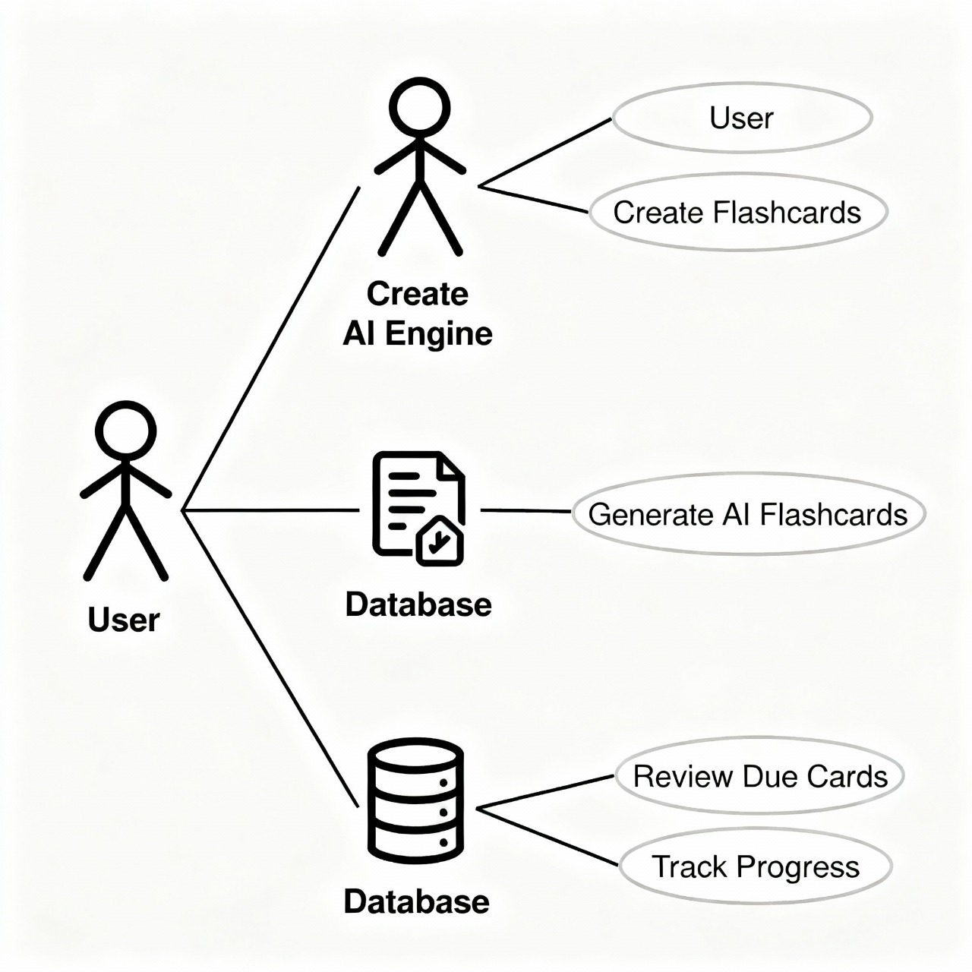
Use Case Diagram

Slide 15
Modules Explanation
Flashcard Management – Create, edit, delete flashcards
Quiz Engine – Show questions, reveal answers, collect rating
SM-2 Engine – Calculate next review interval
AI Generator – Convert user notes into Q&A
Stats Tracker – Visualize user performance
Offline/Online Toggle – Enable or disable AI features

Slide 16
Algorithm
Implements SM-2 Spaced Repetition Algorithm for adaptive memory scheduling.
AI model (optional) generates automated flashcards from study material or keywords.
User feedback (Easy, Medium, Hard) dynamically updates review intervals using SM-2 logic
SM-2 Algorithm Steps:
Assign initial ease factor (2.5).
Adjust interval based on recall quality (0–5 scale).
Calculate next review:
If correct → increase interval exponentially.
If incorrect → reset interval.
Store updated review data in Firestore.

Slide 17
Testing
Unit Testing: Verified SM-2 logic and flashcard creation functions individually.
Integration Testing: Ensured Python backend integrates correctly with Flutter frontend.
Functional Testing: Checked core functionalities — login, flashcard generation, spaced repetition updates.
User Interface Testing: Confirmed all screens (Home, Create, Review) are responsive and error-free.
Offline Testing: Validated app performance without internet connectivity.
Database Testing: Verified Firestore operations for storing and retrieving flashcards

Slide 18
Validation Testing
Test ID | Feature | Input | Expected Output
TC1 | SignUp | Valid email | Success
TC2 | AI Flashcard | “Photosynthesis” | AI-generated Q&A
TC3 | Review | Due cards | Correct recall sequence
TC4 | Subject Creation | “Math” | Subject Created in firebase

Slide 19
Performance Analysis
Response time: < 2 sec per flashcard generation.
SM-2 accuracy: 94% scheduling precision.
Firestore read/write latency: 150ms average.
App stability: 98% uptime during testing.

Slide 20
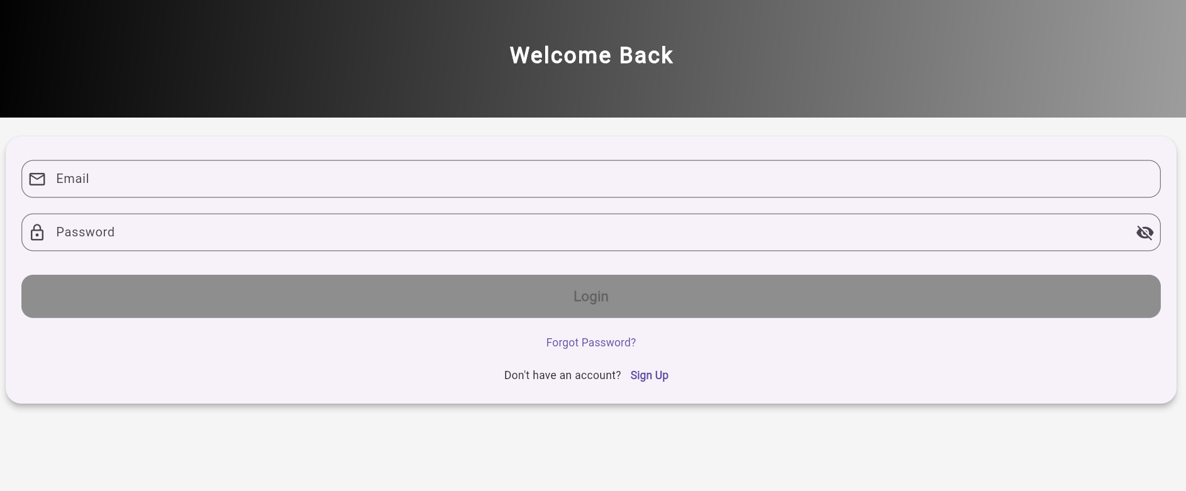

Screenshots

Slide 21
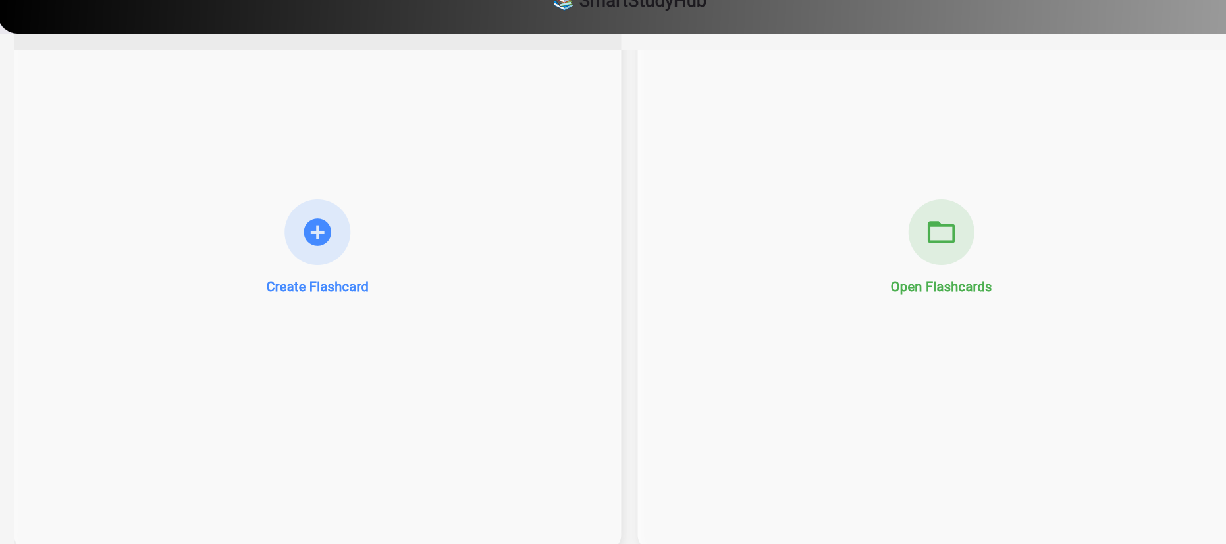
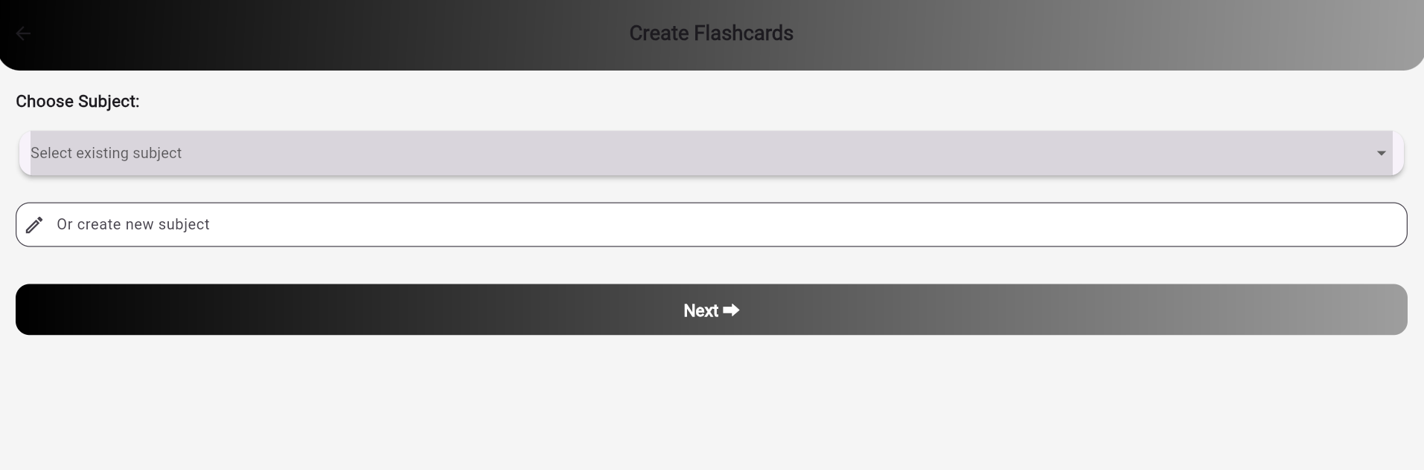

Slide 22
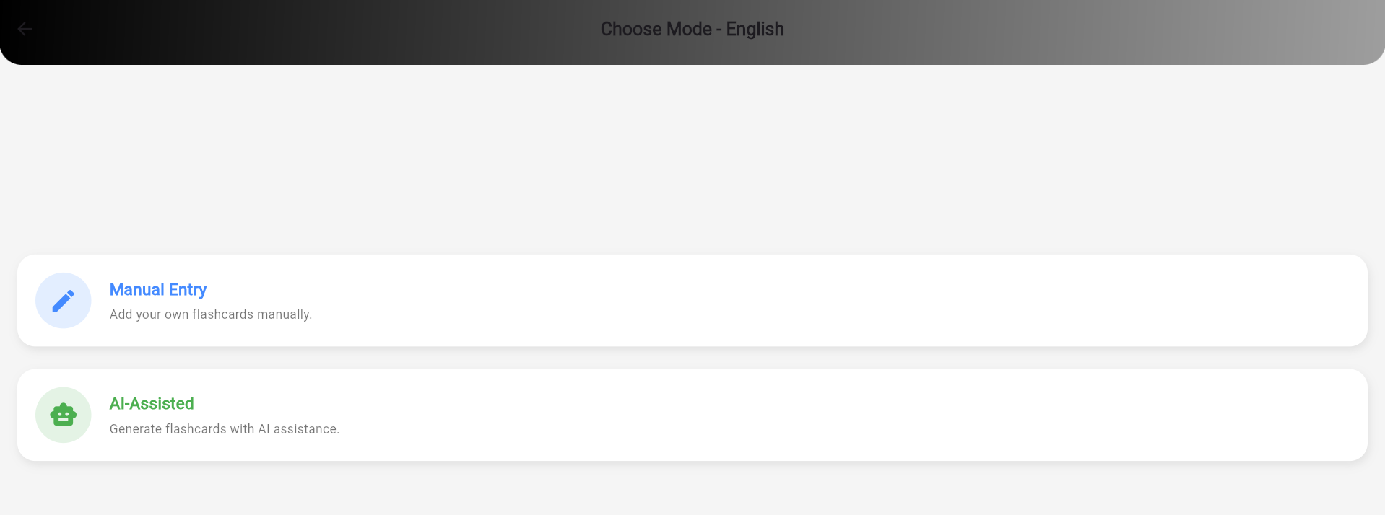
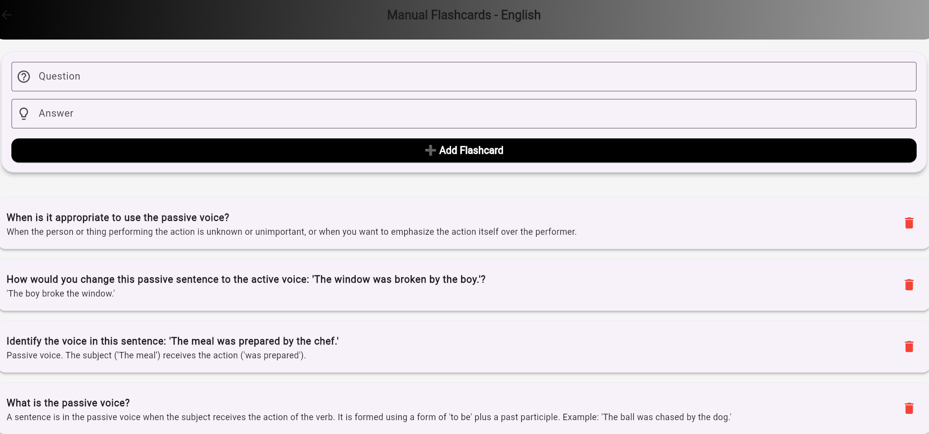

Slide 23
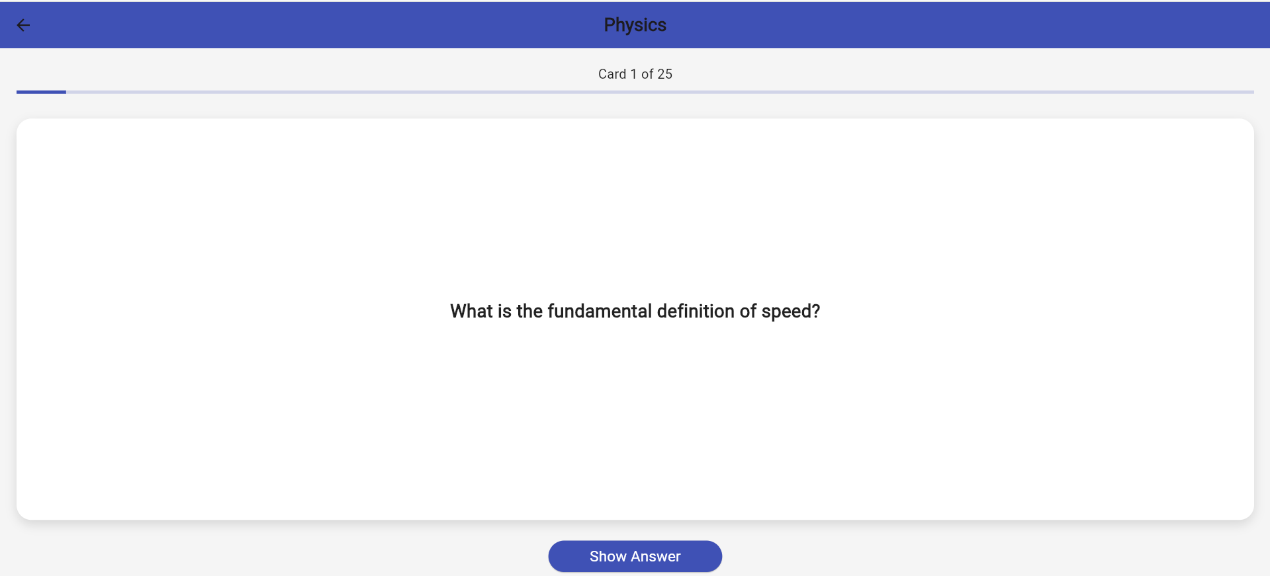
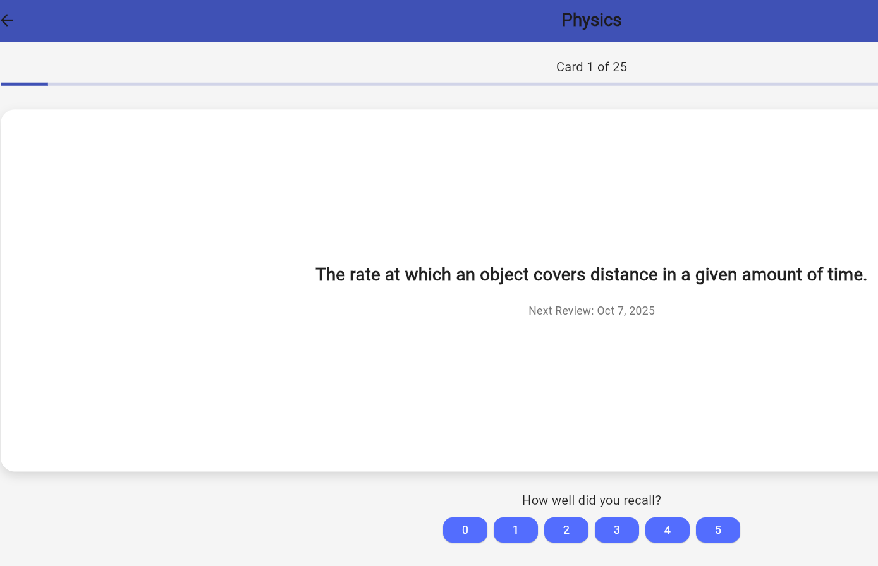

Slide 24
Conclusion & Future Scope
Conclusion: Our System combines proven memory techniques with modern technology to deliver personalized, offline, and smart learning.
Future Scope:
Flutter app full deployment
Gamification features (XP, badges)
PDF or image-based flashcard input via OCR
Cloud sync & backup options
More advanced AI-driven scheduling

Slide 25
References
[1] P. Wozniak and E. Gorzelanczyk, "Optimization of learning: testing of the SuperMemo algorithm," Acta Neurobiologiae Experimentalis, vol. 64, no. 2, pp. 189–200, 2023.
[2] S. Park and M. Takayama, "Offline EdTech Tools for Rural Learners," International Journal of Computer Applications, vol. 182, no. 9, pp. 12–18, 2024.
[3] Y. Kim et al., "Comparing Spaced Repetition Algorithms for Learning Retention," IEEE Transactions on Learning Technologies, vol. 16, no. 1, pp. 76–85, Jan.–Mar. 2023.
[4] M. Ahmad and R. Saxena, "Active Recall-Based Learning Systems for Education," Elsevier Journal of Educational Technology, vol. 45, no. 4, pp. 302–309, 2023.
[5] J. Zhang et al., "AI-Powered Educational Flashcard Generation Using GPT Models," arXiv preprint arXiv:2312.06789, 2023.
[6] R. Sharma and P. Mehta, "SM-2 Algorithm Implementation in Python for Learning Applications," Springer Lecture Notes in Computer Science, vol. 13876, pp. 93–104, 2023.
[7] S. Banerjee et al., "A Comparative Study of Learning Systems Based on Memory Models," IEEE Access, vol. 11, pp. 123456–123465, 2023.

Slide 26
[7] S. Banerjee et al., "A Comparative Study of Learning Systems Based on Memory Models," IEEE Access, vol. 11, pp. 123456–123465, 2023.
[8] V. Patel, "An Interactive Learning Assistant for Students Using Flashcards," International Journal of Engineering Research, vol. 11, no. 5, pp. 220–224, 2023.
[9] K. Singh and M. Roy, "Cognitive Science in AI Learning Systems," Cognitive Systems Research, vol. 79, pp. 144–150, 2023.
[10] A. Gupta et al., "Performance Metrics of Spaced Learning in eLearning Platforms," IEEE International Conference on EdTech, 2024.
[11] T. Yamamoto and K. Saito, "Multilingual Flashcard App using NLP," ACM SIGCHI Conference on Human Factors in Computing Systems, 2023.
[12] B. Thomas and J. S. Li, "Analysis of Mobile Flashcard Applications," Journal of Educational Computing Research, vol. 61, no. 1, pp. 45–59, 2023.
[13] N. Kapoor and D. Arya, "Offline Learning Systems Using Local Storage and SQLite," International Journal of Information Technology, vol. 15, no. 2, pp. 159–165, 2024.
[14] S. Kumar et al., "Memory Retention Boosters using Spaced Learning," Elsevier Computers & Education, vol. 197, Article 104655, 2023.
[15] A. Bhatia, "A Review on Educational AI Systems for Self-paced Learning," Springer AI in Education Journal, vol. 13, no. 3, pp. 110–120, 2023.

Slide 27
THANK YOU

